Slide 1



CSA0307- Data Structures
DEPARTMENT OF COMPUTER SCIENCE AND ENGINEERING
File Compression System (Huffman Coding)
Presented by:
N.Jaffrin(192521200)
M.Charumathi(192524198)
Name of the Guide:Dr.K.Kiruthika

Slide 2
OBJECTIVES
To design and develop a File Compression System using Huffman Coding in C programming.
To implement efficient compression and decompression techniques using Huffman Tree and Min Heap data structures.
To reduce the storage space required for text files by applying lossless data compression.
To improve data transmission efficiency by decreasing the size of files while preserving the original information.

Slide 3
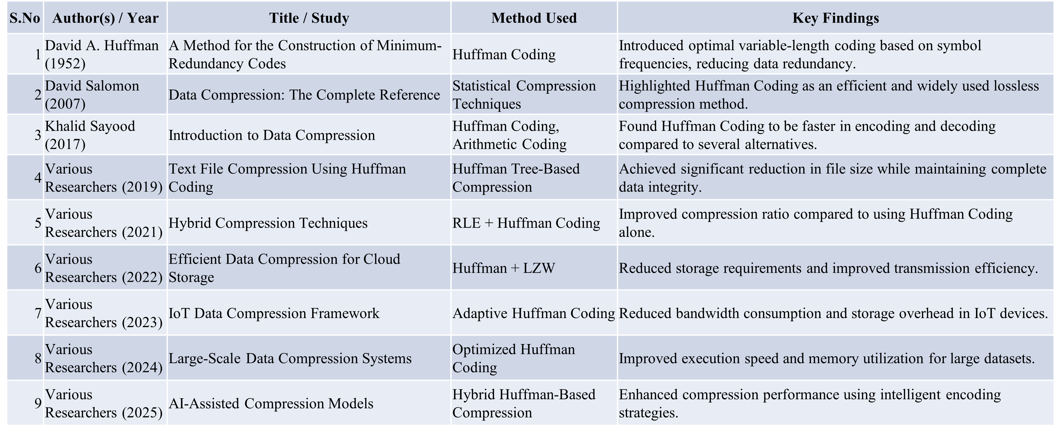
LITERATURE REVIEW

Slide 4
PROBLEM STATEMENT
Rapid growth of digital data increases storage and transmission challenges.
Large files require more disk space and bandwidth.
Traditional storage methods lead to higher storage and transfer costs.
An efficient lossless compression technique is needed to reduce file size without data loss.
This project implements a File Compression System using Huffman Coding in C to compress text files and improve storage and transmission efficiency.

Slide 5
PROPOSED OBJECTIVES
To develop an efficient file compression system using the Huffman Coding algorithm.
To minimize file size while preserving the original data without any loss.
To improve storage utilization and reduce data transmission time.
To implement fast and accurate compression and decompression using Huffman Tree and Min Heap.
To evaluate the system's performance based on compression ratio, execution time, and space savings.
To provide a simple, reliable, and user-friendly solution for text file compression.

Slide 6
ARCHITECTURE
Input File
↓
Read File & Extract Character Frequencies
↓
Construct Huffman Tree
↓
Generate Huffman Codes
↓
Compress File & Store Encoded Data
↓
Decompress Using Huffman Tree/Codes
↓
Verify Output & Analyse Compression Performance

Slide 7
METHODOLOGY
Input File Selection – Read the text file to be compressed.
Frequency Analysis – Count the frequency of each character in the file.
Min Heap Construction – Create a Min Heap using the character frequencies.
Huffman Tree Generation – Build the Huffman Tree by combining nodes with the lowest frequencies.
Code Assignment – Generate unique binary Huffman codes for each character.
File Compression – Replace characters with their Huffman codes and store the compressed data.
File Decompression – Decode the compressed data using the Huffman Tree to restore the original file.

Slide 8
Module 1: Input File Processing and Huffman tree construction
Objective:
To read the input file, calculate character frequencies, and construct the Huffman Tree.
Description
This module reads the input text file and calculates the frequency of each character. Using the frequency table, a Min Heap is created and the Huffman Tree is constructed, which forms the basis for generating optimal Huffman codes.

Slide 9
Input : Text file containing data to be compressed
Output : Character frequency table and Huffman Tree.
Expected Result : A Huffman Tree is successfully generated from the input file, enabling efficient Huffman code generation for file compression.

Slide 10
Module 2:Huffman Code Generation, Compression & Decompression
Objective:
To generate Huffman codes, compress the input file, and restore the original file through decompression.
Description:
This module generates binary Huffman codes from the Huffman Tree, compresses the input file by replacing characters with their codes, and decompresses the compressed file to recover the original data without any loss.

Slide 11
Input : Huffman Tree and input/compressed file.
Output : Compressed file and decompressed original file.
Expected Result : The file is compressed with reduced storage space and accurately decompressed to reproduce the original content.

Slide 12
CONCLUSIONS
The File Compression System using Huffman Coding was successfully designed and implemented using the C programming language.
The project effectively reduces file size by assigning variable-length binary codes based on character frequencies, resulting in efficient lossless compression.
The Huffman Tree and Min Heap data structures enabled optimal code generation and improved compression performance.

Slide 13
REFERENCES
Shah, M., Yu, X., Di, S., Becchi, M., & Cappello, F. (2023). Lightweight Huffman Coding for Efficient GPU Compression. Proceedings of the ACM International Conference on Supercomputing (ICS 2023), pp. 99–110.
Nasif, A., Othman, Z. A., Sani, N. S., & Hasan, M. K. (2024). Huffman Deep Compression of Edge Node Data for Reducing IoT Network Traffic. IEEE Access.
Prakash, F., Singh, V., & Saxena, A. K. (2024). An Evaluation of Arithmetic and Huffman Coding in Data Compression & Source Coding. Proceedings of the International Conference on Optimization Computing and Wireless Communication (ICOCWC 2024).
Lin, Y., Liu, J.-C., Chang, C.-C., & Chang, C.-C. (2024). Lossless Recompression of Vector Quantization Index Table for Texture Images Based on Adaptive Huffman Coding Through Multi-Type Processing. Symmetry, 16(11), 1419.
Mahfi, M. S., Hasan, M. M., & Hossain, G. (2025). OBHS: An Optimized Block Huffman Scheme for Real-Time Audio Compression. arXiv preprint.

Slide 14


